Slide 1
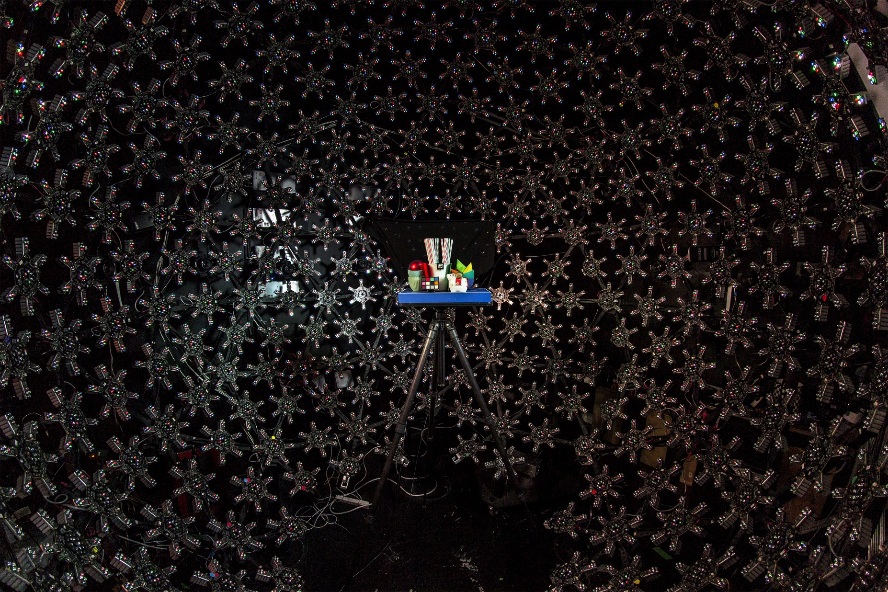
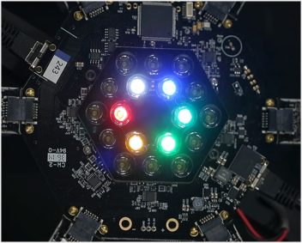
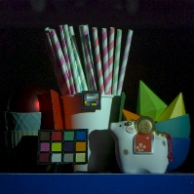
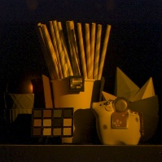
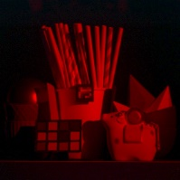
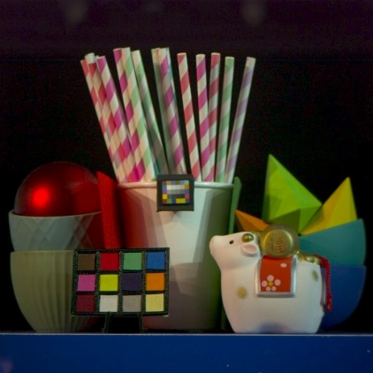
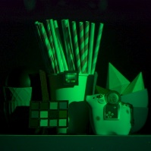
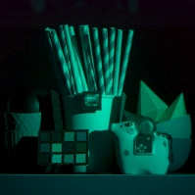
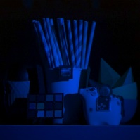
Efficient Multispectral Reflectance Function Capture for Image-Based Relighting
Chloe LeGendre Xueming Yu Paul Debevec
USC Institute for Creative Technologies

Slide 2
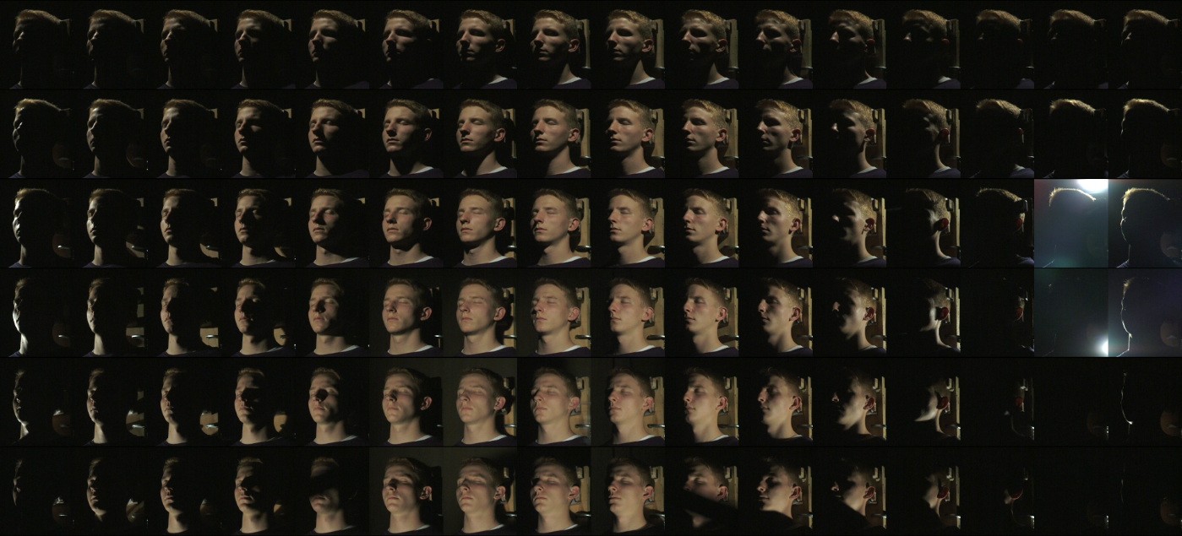
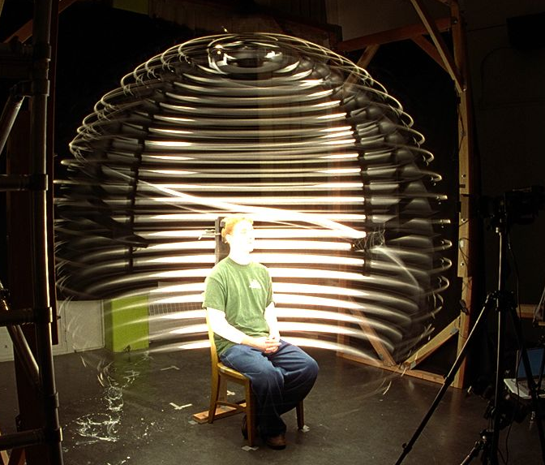
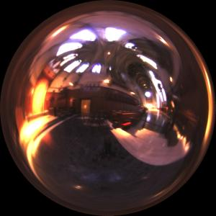

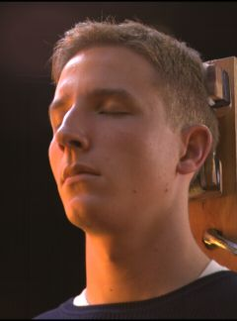
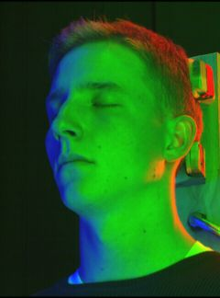
Image-Based Relighting
Reflectance field basis images, R(ɵ, ɸ, u, v)
“Acquiring the Reflectance Field of a Human Face”
Debevec et al. [SIGGRAPH 2000]

Slide 3
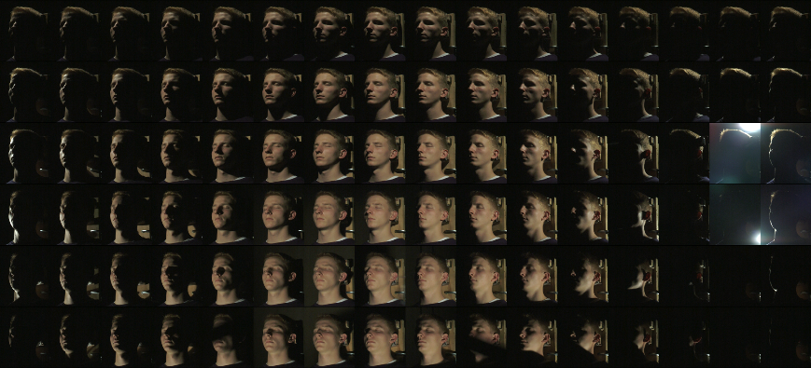
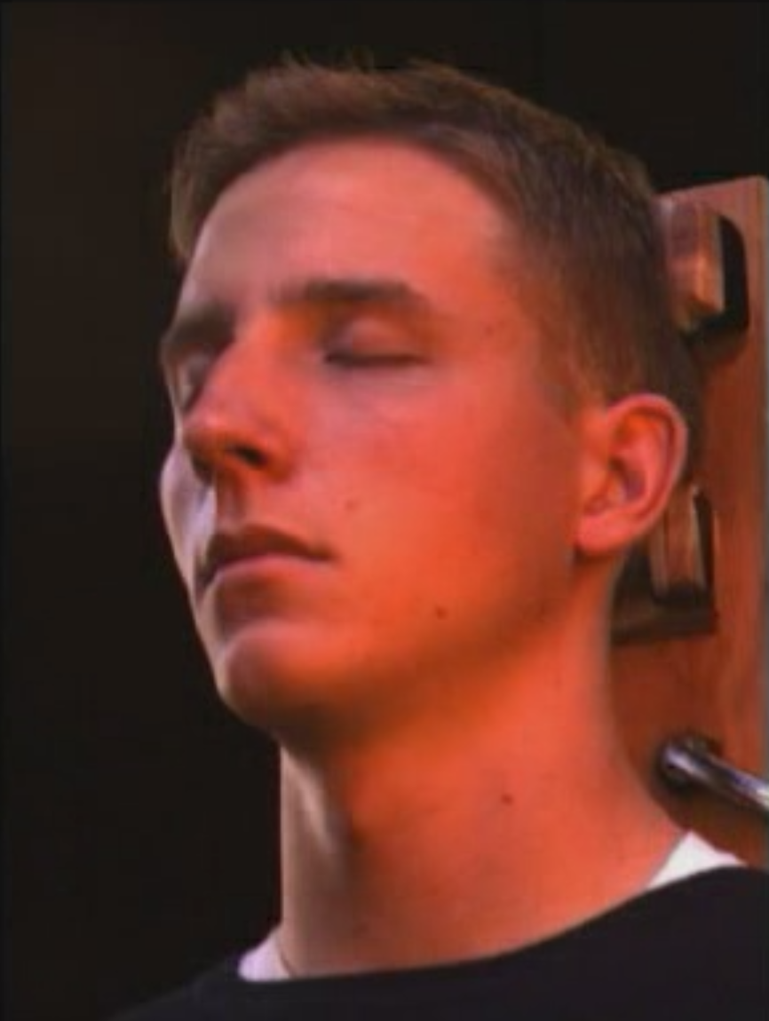
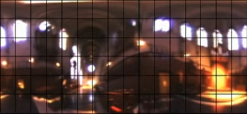
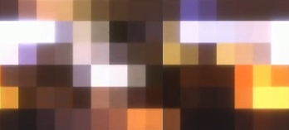
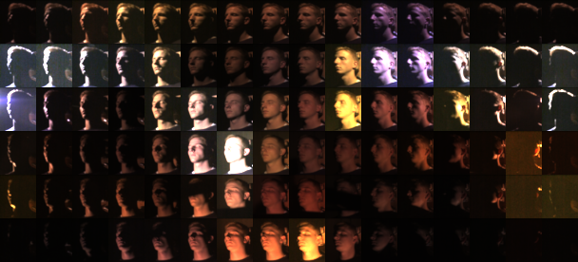
Image-Based Relighting
RGB
light
probe
∑
RGB scaled
lighting basis images

Slide 4
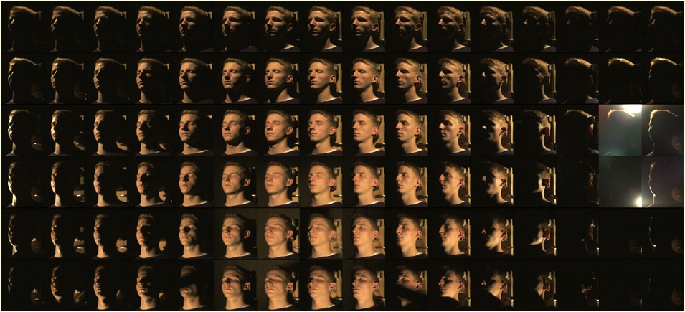
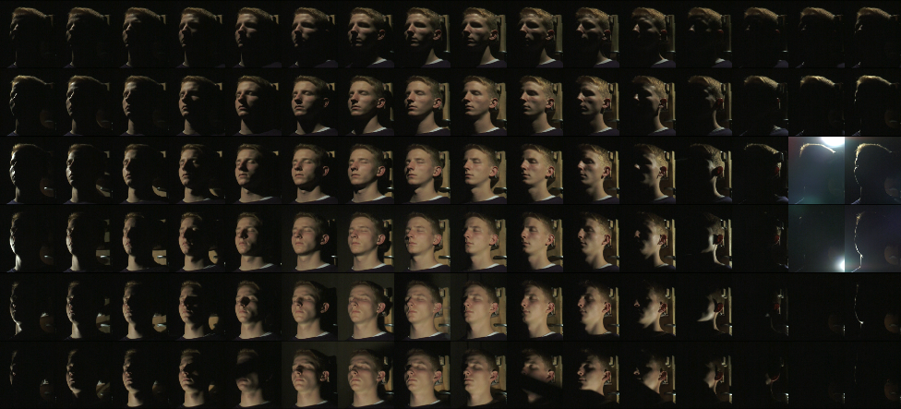
Image-Based Relighting
lighting basis images
white balanced lighting basis images

Slide 5
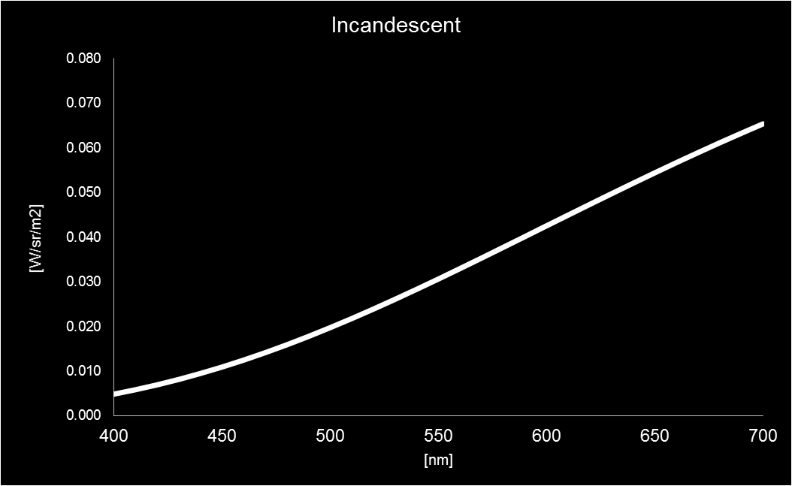
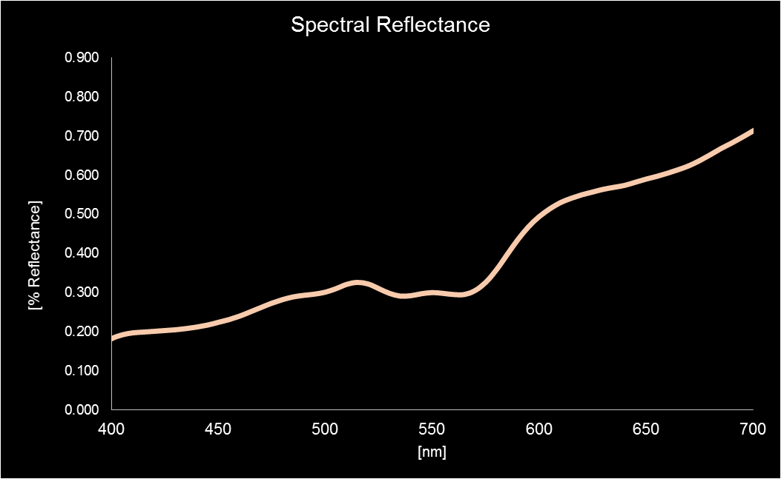
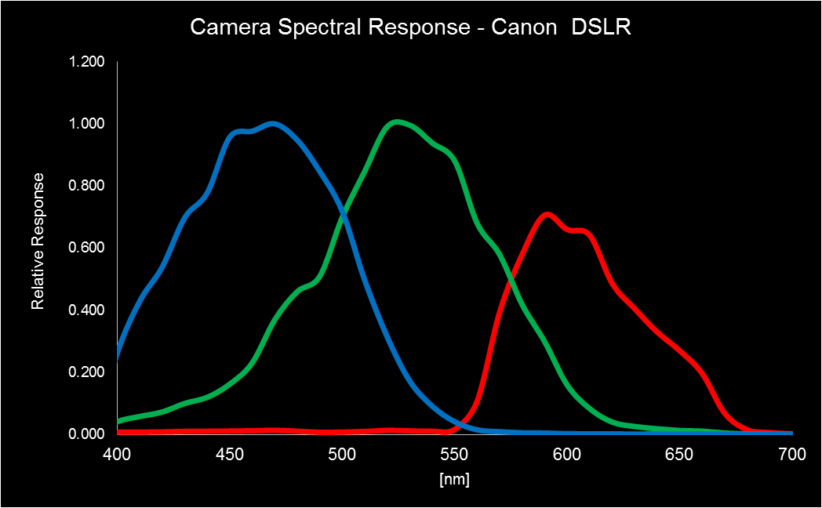
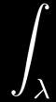

Pixel Values = Integral of modulated spectra
Illuminant
Material Reflectance
Camera Response
R
GB
(skin)
=
(
*
*
)
=

Slide 6
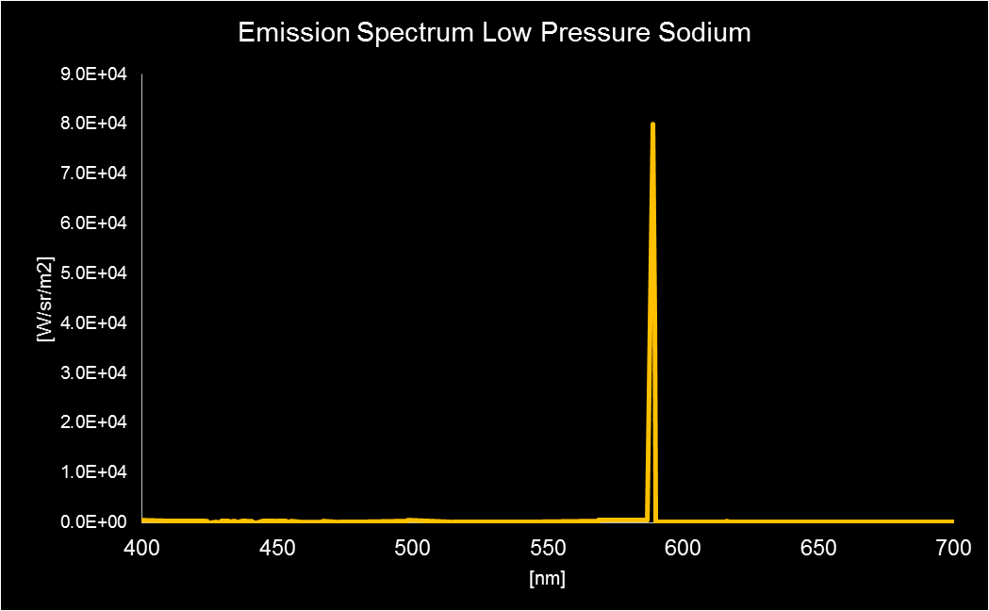
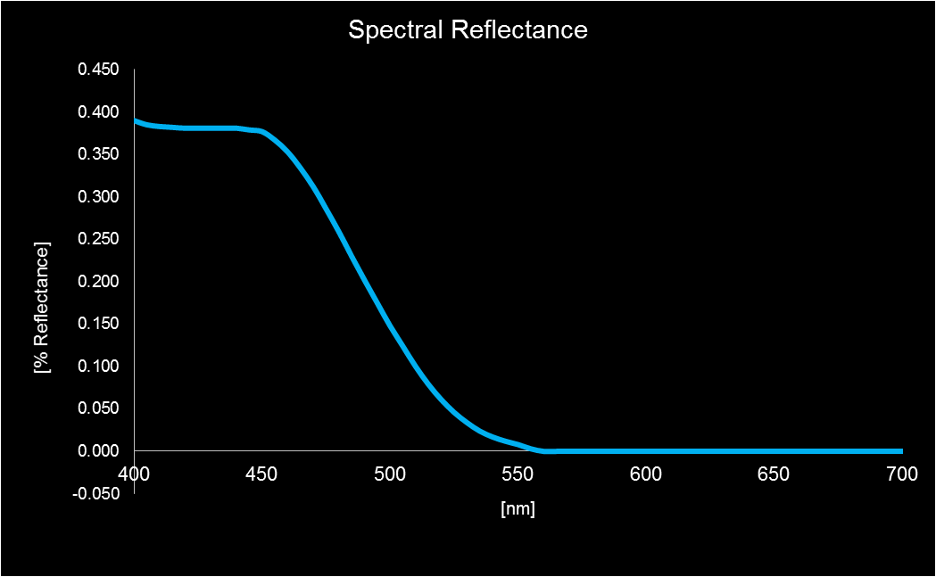
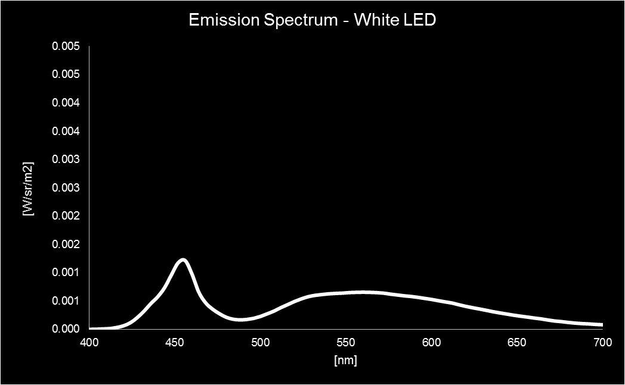
Color Rendition Error: An Extreme Case
Sodium Illumination
Camera Response
Light Probe
RGB
IBRL Result
(
)
=
*
=
*
(1, 0.4, 0)
(0, 0.1, 0)
Material Reflectance
Real Lighting
(
*
*
=
(0, 0, 0)
White LED (Refl. Field)
WB Reflectance Field RGB
(
*
*
=
(0, 0.26, 1)
WB

Slide 7
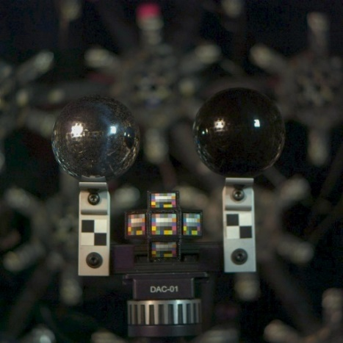
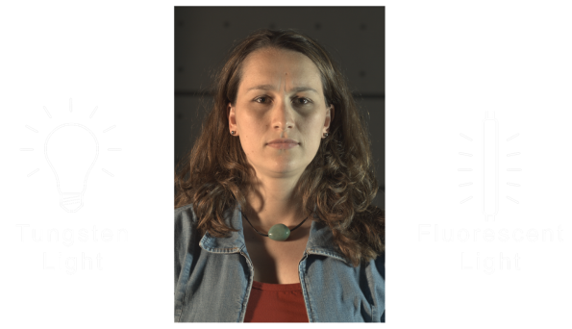
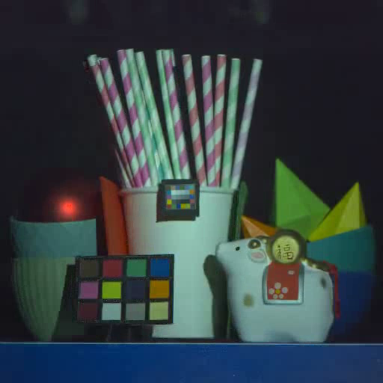
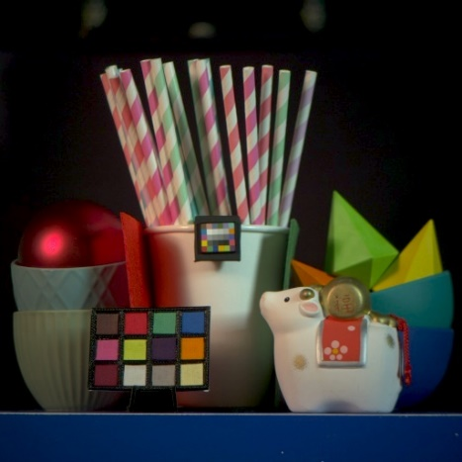

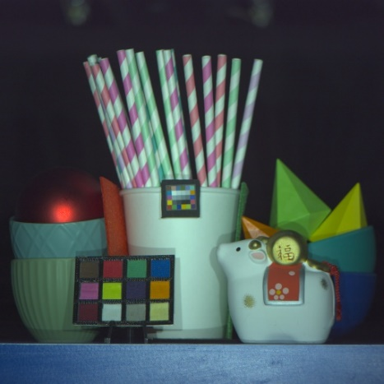
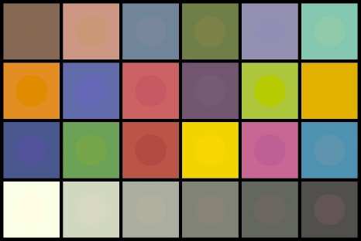
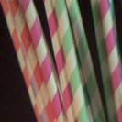
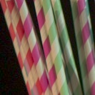
Image-Based Relighting Color Rendition
reflectance field
lighting capture
real photo
relighting result
Average color
error = 2.7%

Slide 8
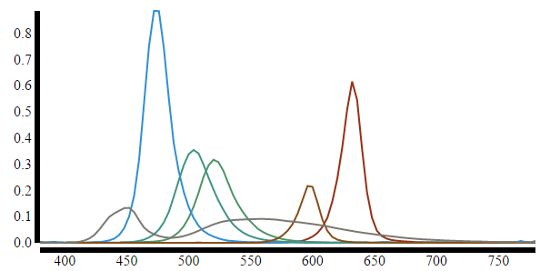
Multispectral Light Stage
6 LED
spectra

Slide 9
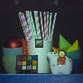
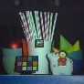
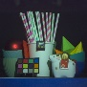
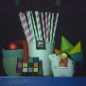
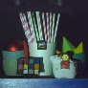
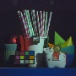
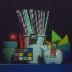
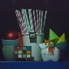
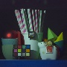
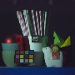
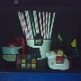
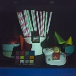
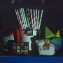


































































Multispectral Reflectance Field
Multispectral reflectance field basis images, R(ɵ, ɸ, u, v, s)

Slide 10















































































RGB Image-Based Relighting
RGB
Reflectance
Field
RGB
Light
Probe
Multispectral Image-Based Relighting
Multispectral
Reflectance
Field
?
?
Multispectral Light Probe?

Slide 11

Multispectral Lighting Environment
“Color Chart Panorama”
“Practical Multispectral Lighting Reproduction”
LeGendre et al. [SIGGRAPH 2016]

Slide 12









Matching A Color Chart with Multispectral LEDs
α_{R} ∙
+
+
α_{G} ∙
α_{B} ∙
red
green
blue
≈
+
+
+
α_{C} ∙
α_{A} ∙
α_{W} ∙
color chart
lit by tungsten
cyan
amber
white
“Practical Multispectral Lighting Reproduction”
LeGendre et al. [SIGGRAPH 2016]

Slide 13






Image-Based Relighting Results
real photo
RGB relit result
multispectral relit result
Average color
error = 2.7%
Average color
error = 2.0%

Slide 14














































































Monochrome Multispectral Reflectance Field
Monochrome multispectral reflectance field basis images, R(ɵ, ɸ, u, v, s)

Slide 15


















Matching A Color Chart with a Monochrome Camera
color chart
lit by tungsten
red
green
blue
cyan
amber
white
+
+
+
≈
R
R_{R} ∙
+
+
R_{A} ∙
R_{W} ∙
R_{G} ∙
R_{B} ∙
R_{C} ∙
+
+
+
≈
G
G_{R} ∙
+
+
G_{A} ∙
G_{W} ∙
G_{G} ∙
G_{B} ∙
G_{C} ∙
+
+
+
≈
B
B_{R} ∙
+
+
B_{A} ∙
B_{W} ∙
B_{G} ∙
B_{B} ∙
B_{C} ∙

Slide 16



Image-Based Relighting Results
monochrome camera multispectral relit result
real photo
RGB relit result
multispectral relit result
Error = 2.7%
Error = 2.0%
Error = 3.2%

Slide 17
Multispectral Reflectance Field: Number of Images
…
6 LED
spectra
=
…

Slide 18



Spectral Promotion
real spectral
reflectance image
(reference source)
real brightness
image
(directional source)
synthetic spectral reflectance image
(directional source)
=

Slide 19




Spectral Promotion

Slide 20
Multispectral Reflectance Field: Number of Images
full multispectral basis
…
6 LED
spectra
vs.
spectral promotion
+
6 LED
spectra
…

Slide 21






















Spectral Promotion
Real Lighting Basis Images
Spectrally Promoted Lighting Basis Images
Full Sphere of Even Illumination
Absolute Difference

Slide 22






Image-Based Relighting Results
color camera
monochrome camera
multispectral relit result
spectrally promoted
multispectral relit result
spectrally promoted
Error = 0.7%
Error = 3.8%

Slide 23

Image-Based Relighting Results
real photo
spectrally promoted
RGB relit result

Slide 24






Spectral Promotion with Diffuse/Specular Separation
diffuse
specular
blended specular
diffuse promoted
specular promoted
diffuse promoted

Slide 25





Spectral Promotion with Diffuse/Specular Separation
naïve (diffuse) promoted
diffuse/specular promoted
real basis image
difference images

Slide 26







Key Takeaways
Multispectral image-based lighting improves color rendition for this subject and lighting environment.
Spectral promotion for fast multispectral reflectance field capture.
=
Diffuse/Specular separation improves spectral promotion.
+
=
Accurate and efficient – suitable for relighting living subjects.

Slide 27

Thanks
Thanks: Randy Hill, Clarke Lethin, Kathleen Haase, Christina Trejo, Keith Snail, Kathryn Rock, Jay Busch, Andrew Jones, Graham Fyffe, Koki Nagano, Shanhe Wang, Loc Huynh, Dan Sherlock, Joe di Gennaro
Research Sponsors: Army Research Lab, STTC, US Army RDECOM, Natick Soldier Systems Center, USC Office of the Provost, USC Annenberg Fellowship
http://gl.ict.usc.edu/ legendre@ict.usc.edu

Slide 28





Reflectance Functions
R_{u,v}(ɵ, ɸ) = I_{[R,G,B],} _{ɵ, ɸ} (u, v)
ɵ
ɸ

Slide 29









RGB Light Probes and RGB Image-Based Relighting
light map
reflectance function
lighting product
rendered pixel
white
balance
R (u,v)
1
G (u,v)
1
B (u,v)
1

